Slide 1
SOCCER WORLD CUP DATA ANALYSIS (1930-2022)
Presented By: Abbas Hussain Syed and Anmol Singh
(Group-2)
Notes:
Hello everyone our dashboard topic is based on the soccer world cup dataset which was downloaded from Kaggle.com. Me and my teammate Anmol we be presenting the slides. so lets get ahead with the introduction.

Slide 2
Introduction:
Welcome to the exciting world of soccer, where people love playing and watching games all over the world. In this presentation, we'll talk about the FIFA World Cup, which has been happening since 1930 until 2022.
We'll look at how the World Cup has changed over time, like how many teams joined, how many matches were played, how many goals were scored, and the average number of goals per game. We'll use careful examination and pictures of the data to find interesting patterns, important moments, and the big story of the World Cup over many years.
From the first World Cup in Uruguay to the most recent one in Qatar, each tournament has been really important in soccer history. Let's explore the stories of victory, defeat, and amazing moments that make the FIFA World Cup so special. Source of data: https://www.kaggle.com/datasets/iamsouravbanerjee/fifa-football-world-cup-dataset
BI Tool used: TABLEAU

Slide 3
Map Chart Explanation:
Description of "Historical Overview of Hosts"
Map based on Longitude (generated) and Latitude (generated). The marks are labeled by Host. Details are shown for Host. The data is filtered on Champion and Action (Champion). The Champion filter keeps 9 of 9 members. The Action (Champion) filter keeps 9 members.
Dimensions:
Champion has 9 members on this sheet Members: Argentina, Brazil, England, France, Germany
Measures:
Latitude (generated) ranges from -33.17 to 66.22 on this sheet. Longitude (generated) ranges from -101.7 to 137.9 on this sheet.

Slide 4
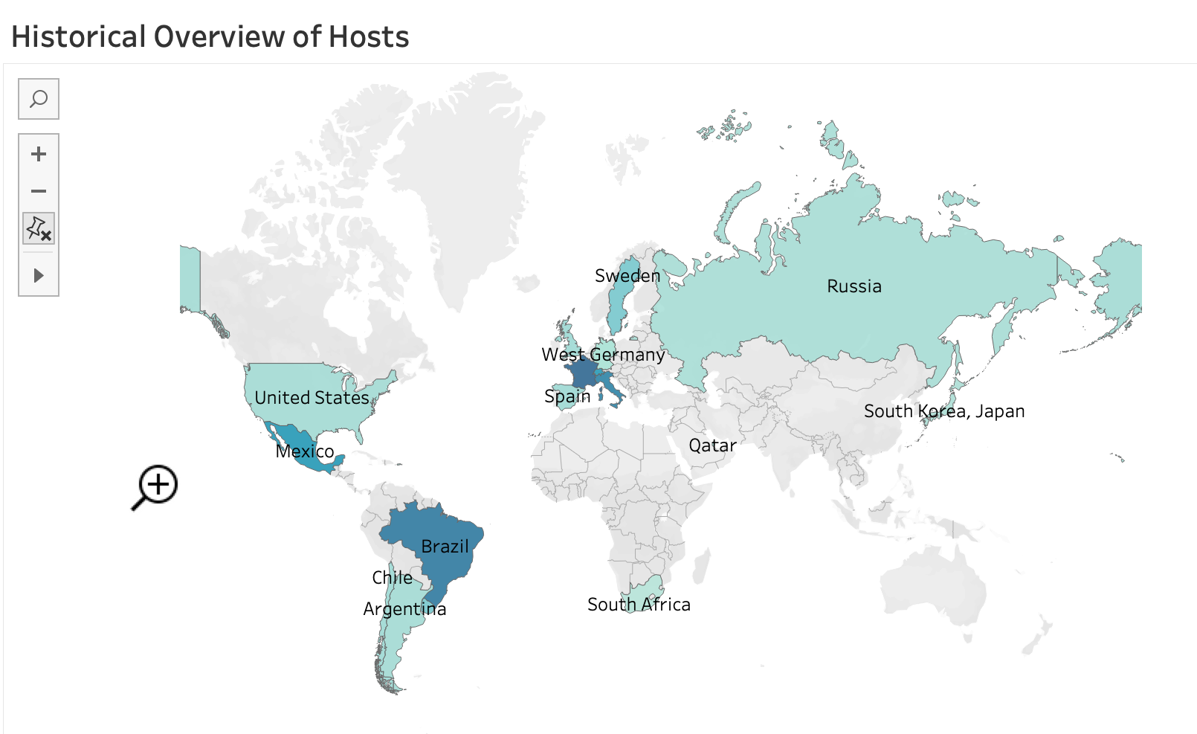
Map Chart:

Slide 5
Packed Bubbles Chart Explanation:
Description of "Historical Count of FIFA World Cup Champions"
Champion and Count of champions. Color shows details about Champion. Size shows count of Champion. The marks are labeled by Champion and Count of champions. The data is filtered on Action (Runner Up,Year), which keeps 22 members. The view is filtered on Champion, which keeps 9 of 9 members.
Dimensions
Champion has 9 members on this sheet Members: Argentina; Brazil; England; France; Germany; ...
Measures
Count of Champion ranges from 1 to 5 on this sheet. 1 logical table used to determine value: Count of champions ranges from 1 to 5 on this sheet. The formula is COUNT([Champion])

Slide 6
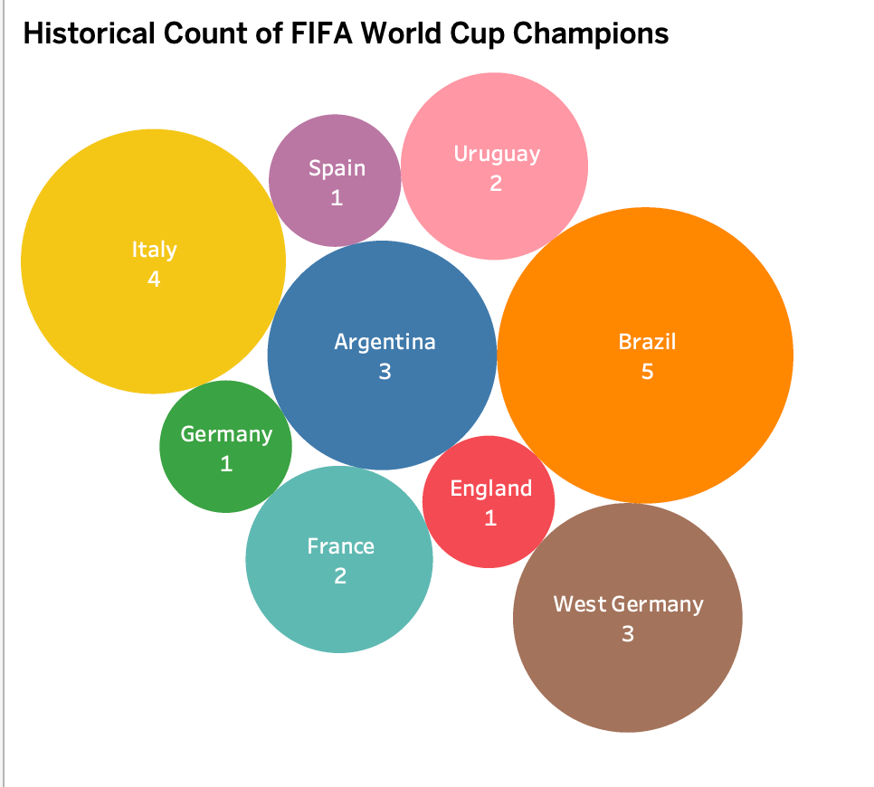
Packed Bubbles Chart:

Slide 7
Gantt Chart Explanation:
Description of "Annual Runner-Up Count: A Year-by-Year Overview"
Year broken down by Runner Up. Color shows details about Year. Size shows Calculation1. The marks are labeled by Year. The data is filtered on Action (Champion) and Champion. The Action (Champion) filter keeps 9 members. The Champion filter keeps 9 of 9 members.
Dimensions
Champion has 9 members on this sheet Members: Argentina; Brazil; England; France; Germany; ... Runner Up has 11 members on this sheet Members: Brazil; Germany; Hungary; Italy; West Germany; ... Year ranges from 1930 to 2022 on this sheet.
Measures
Calculation1 has the value 1 on this sheet. The formula is COUNT([Year])

Slide 8
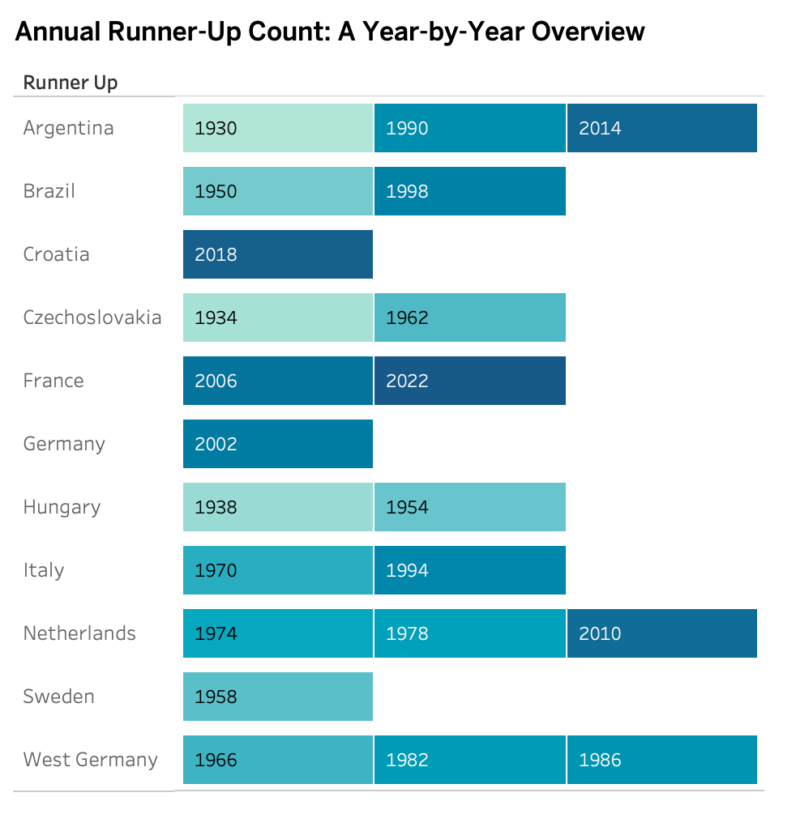
Gantt Chart:

Slide 9
Line Chart Explanation:
Description of "Historical Count of Goals By Year"
The trend of sum of Goals Scored for Year. The marks are labeled by sum of Goals Scored. The data is filtered on Action (Champion), Champion and Action (Runner Up,Year). The Action (Champion) filter keeps 9 members. The Champion filter keeps 9 of 9 members. The Action (Runner Up,Year) filter keeps 22 members.
Dimensions:
Champion has 9 members on this sheet Members: Argentina; Brazil; England; France; Germany; ... Year ranges from 1930 to 2022 on this sheet.
Measures:
Sum of Goals Scored ranges from 70 to 172 on this sheet.

Slide 10
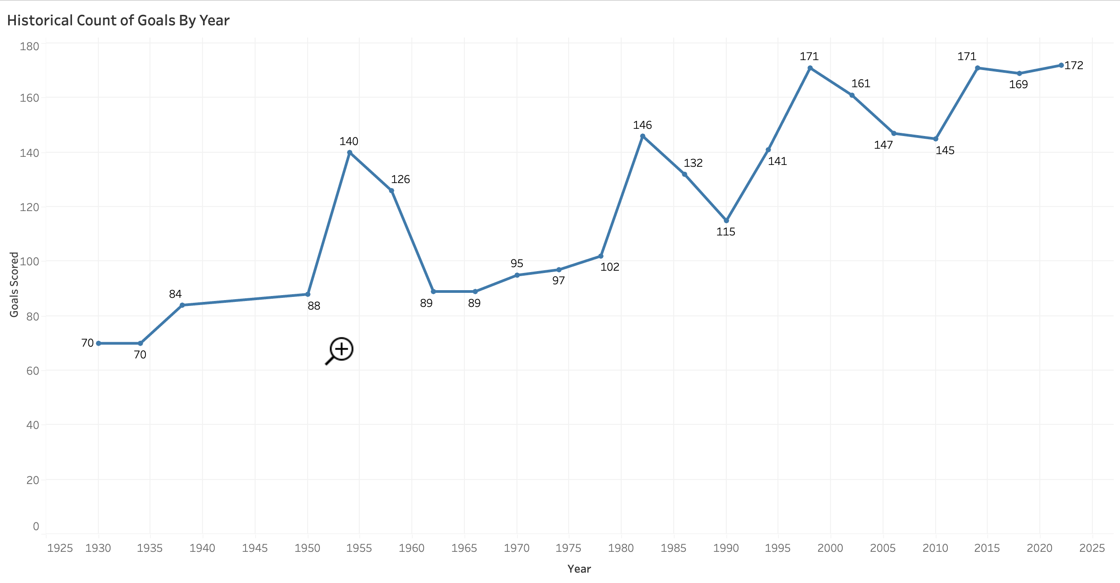
Line Chart:

Slide 11
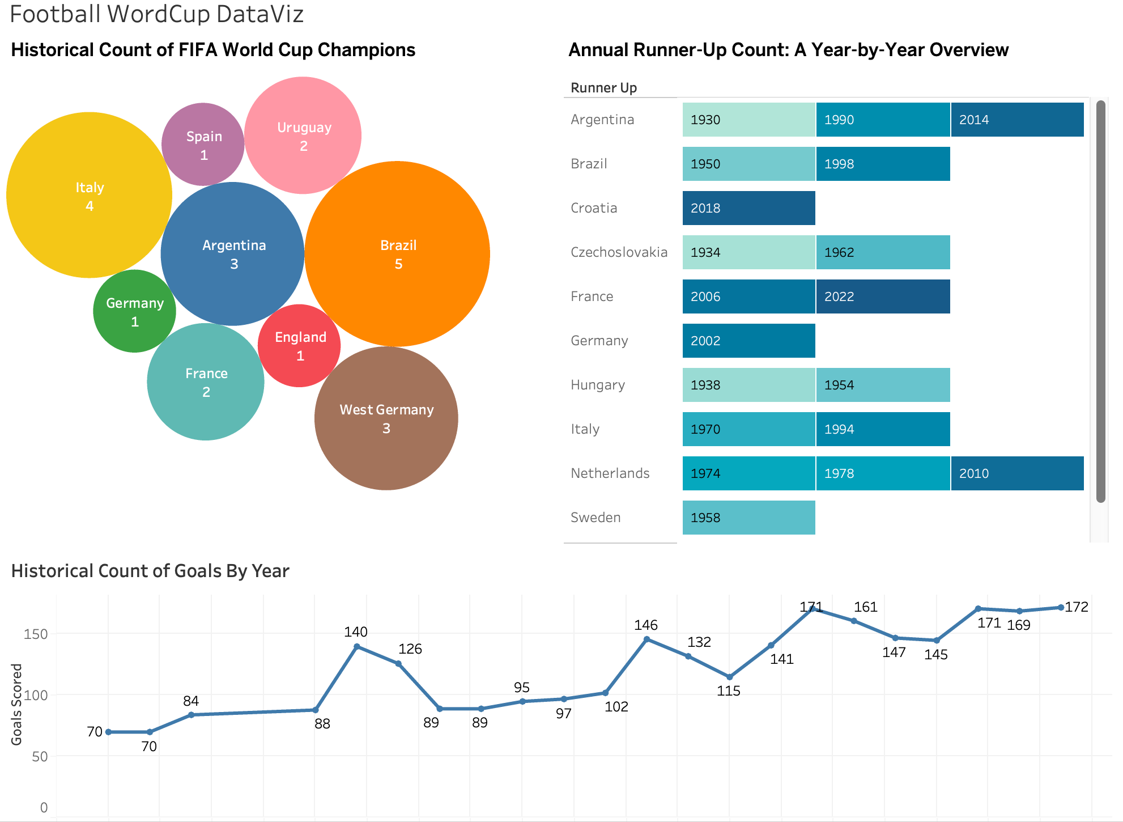
Dashboard Story-1:

Slide 12
Tree Map Chart Explanation:
Description of "GOALS SCORED BY TEAMS IN SOCCER WORLD CUP"
Host, Year, sum of Goals Scored and sum of Matches Played. Color shows details about Host. Size shows sum of Goals Scored. The marks are labeled by Host, Year, sum of Goals Scored and sum of Matches Played.
Dimensions:
Host has 18 members on this sheet
Members: Argentina; Brazil; France; Spain; West Germany
Year ranges from 1930 to 2022 on this sheet.
Measures:
Sum of Goals Scored ranges from 70 to 172 on this sheet.
Sum of Matches Played ranges from 16 to 64 on this sheet.

Slide 13
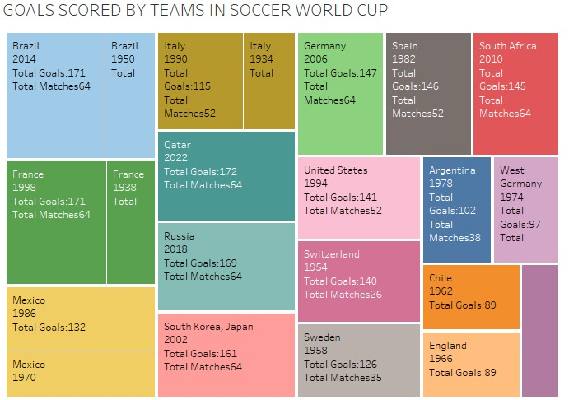
Tree Map Chart Explanation:

Slide 14
Side-By-Side Bar Chart Explanation:
Description of "AVG GOALS SCORED PER GAME"
Avg Goals Per Game and Goals Scored for each Champion. Color shows details about Avg Goals Per Game and Goals Scored.
Dimensions:
Measure Names has 2 members on this sheet
Members: Avg Goals Per Game; Goals Scored
Champion has 9 members on this sheet
Members: Argentina; Brazil; England; France; Germany
Measures:
Measure Values ranges from 2.3 to 612.0 on this sheet.

Slide 15
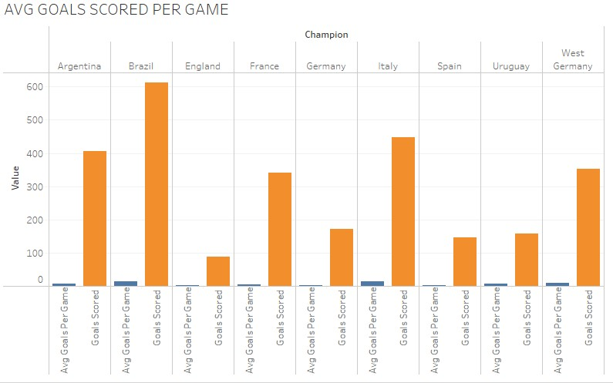
Side-By-Side Bar Chart:

Slide 16
Line Chart Explanation:
Description of "AVG GOALS PER TEAM "
The trend of sum of Avg Goals Per Team for Year. The marks are labeled by sum of Avg Goals Per Team.
Dimensions:
Year ranges from 1930 to 2022 on this sheet.
Measures:
Sum of Avg Goals Per Team ranges from 4.380 to 8.750 on this sheet.

Slide 17
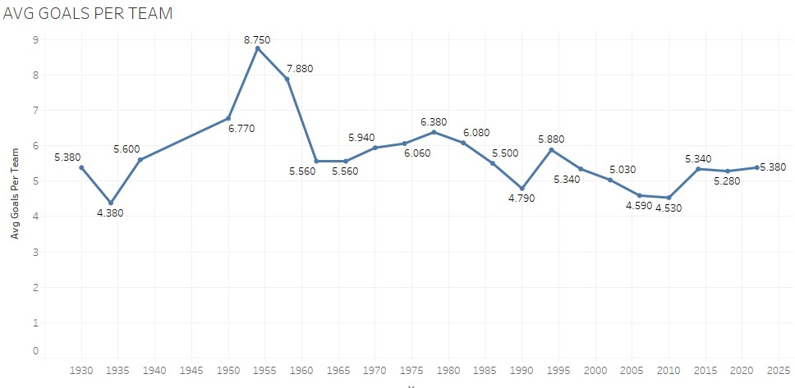
Line Chart:

Slide 18
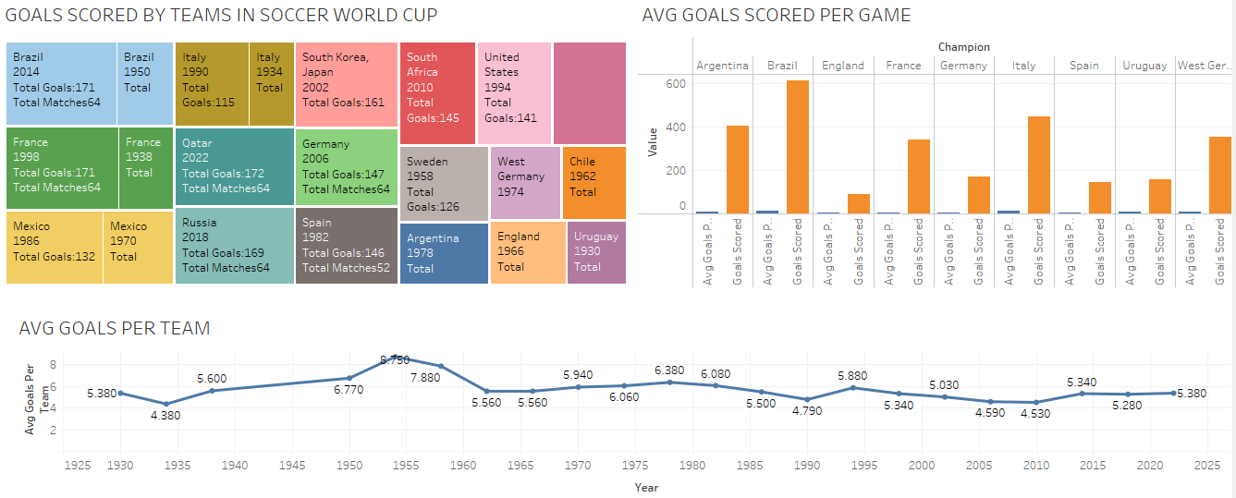
Dashboard Story-2:

Slide 19
Conclusion:
Top Performing Teams
Brazil - Brazil stands out as the most successful team in World Cup history up to 2022, having won the championship five times (1958, 1962, 1970, 1994, and 2002) and finishing as runners-up twice (1950 and 1998). Their consistent performances across decades highlight their dominance in world football.
Germany (including West Germany) - Germany has been a powerhouse in World Cup history, winning four titles (1954, 1974, 1990 as West Germany, and 2014 as Germany) and finishing as runners-up four times (1966 as West Germany, 1982 as West Germany, 1986 as West Germany, and 2002 as Germany). They also secured third place four times (1934, 1970 as West Germany, 2006, and 2010), underlining their consistent presence in the top ranks.
Italy - Italy has claimed the World Cup four times (1934, 1938, 1982, and 2006) and has been runners-up twice (1970 and 1994). Their victories span across different eras, showing their ability to compete at the highest level through generations.
Argentina - Argentina has won the World Cup three times (1978, 1986, and 2022) and has been runners-up three times (1930, 1990, and 2014), demonstrating their strong performances in both early and modern eras of the competition.
France - France has lifted the World Cup twice (1998 and 2018) and finished as runners-up twice (2006 and 2022). Their successes are more recent, marking them as a dominant force in contemporary football.

